Slide 1
Assessing Validity and Reliability in Diagnostic and Screening Tests: Session 2
Patricia Butterfield & Naomi Chaytor
October 18th, 2017

Slide 2
Objective-hour 2:
Using case study examples and clinical vignettes, calculate and interpret sensitivity, specificity, positive predictive value, and negative predictive value.

Slide 3
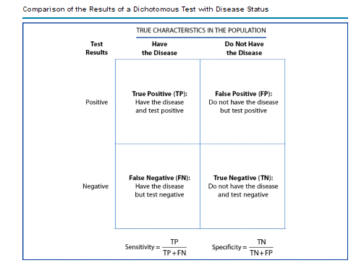
  Create a table from the data on facial weakness from table 5 in the paper
  Calculate sensitivity and specificity

Slide 4
ANSWER 1

Slide 5
Sensitivity: 8x100/46 = 17%
Specificity: 18x100/19 = 95%
ANSWER 1:
 | Focal Lesion | No Lesion
Abnormal Exam | 8 (True Pos) | 1 (False Pos) | 9
Normal Exam | 38 (False Neg) | 18 (True Neg) | 56
 | 46 | 19 | 65

Slide 6
Calculate PPV and NPV:
    PPV = true positives x 100
    true positives + false positives
    NPV = true negatives x 100
    true negatives + false negatives
  Interpret these values – Clinical implications?

Slide 7
ANSWER 2

Slide 8
ANSWER 2:
 | Focal Lesion | No Lesion
Abnormal Exam | 8 (True Pos) | 1 (False Pos) | 9
Normal Exam | 38 (False Neg) | 18 (True Neg) | 56
 | 46 | 19 | 65
    PPV = 8 (TP) x 100/9 (TP + FP) = 89%
    NPV = 18 (TN) x 100/56 (TN + FN) = 32%
    If you have a focal exam, you have an 89% likelihood of having a focal lesion
    If you have a normal exam, you have a 32% chance of not having a lesion (you are still more likely to have a lesion!)

Slide 9
What is the prevalence/Base Rate of focal lesions in the paper?
  Does this matter?
  What would happen if the prevalence of disease changed?
Notes:
71% prevalence of focal lesion in paper sample

Slide 10
Half the groups (1% prevalence):
 | Focal Lesion | No Lesion
Abnormal Exam | 5 | 149 | 154
Normal Exam | 25 | 2821 | 2846
 | 30 | 2970 | 3000
Half the groups (33% prevalence):
 | Focal Lesion | No Lesion
Abnormal Exam | 5 | 3 | 8
Normal Exam | 25 | 57 | 82
 | 30 | 60 | 90

Slide 11
ANSWER 3 & 4

Slide 12
ANSWER 3:
  1% prevalence of focal lesions:
    PPV = 5 (TP) x 100/154 (TP + FP) = 3%
    NPV = 2821 (TN) x 100/2846 (TN + FN) = 99%
    If you have a focal exam, you have a 3% chance of having a focal lesion (higher than 1%, but not much)
    If you have a normal exam, you have a 99% chance of not having a lesion (same as before test)

Slide 13
ANSWER 4:
  33% prevalence of focal lesion:
    PPV = 5 (TP) x 100/8 (TP + FP) = 63%
    NPV = 57 (TN) x 100/82 (TN + FN) = 70%
    If you have a focal exam, you have a 63% chance of having a focal lesion (twice as good as base rate)
    If you have a normal exam, you have a 70% chance of not having a lesion (about the same as base rate)

Slide 14

The end.

